Slide 1
Canny and Sobel algorithms
Suleimenova Inkara

Slide 2
Machine Vision vs Computer Vision
Computer Vision (CV) is an artificial intelligence field focused on automating the capture and processing of images, with an emphasis on image analysis. It aims not only to see but also to interpret and provide meaningful insights based on observations. CV can analyze various visual data, including images, videos, and 3D point clouds, to extract valuable information.

Slide 3
Machine Vision vs Computer Vision
Computer Vision (CV) is an artificial intelligence field focused on automating the capture and processing of images, with an emphasis on image analysis. It aims not only to see but also to interpret and provide meaningful insights based on observations. CV can analyze various visual data, including images, videos, and 3D point clouds, to extract valuable information.
Machine Vision, a subset of Computer Vision, is specifically tailored for industrial applications. It often uses CV techniques for tasks like object detection, classification, and tracking.

Slide 4
Machine Vision vs Computer Vision
Computer Vision (CV) is an artificial intelligence field focused on automating the capture and processing of images, with an emphasis on image analysis. It aims not only to see but also to interpret and provide meaningful insights based on observations. CV can analyze various visual data, including images, videos, and 3D point clouds, to extract valuable information.
Machine Vision, a subset of Computer Vision, is specifically tailored for industrial applications. It often uses CV techniques for tasks like object detection, classification, and tracking.
The main distinction between these fields lies in their applications. Computer Vision has a broader scope, applied in areas like digital marketing and autonomous vehicles. In contrast, Machine Vision is focused on industrial tasks such as quality control and automation.

Slide 5
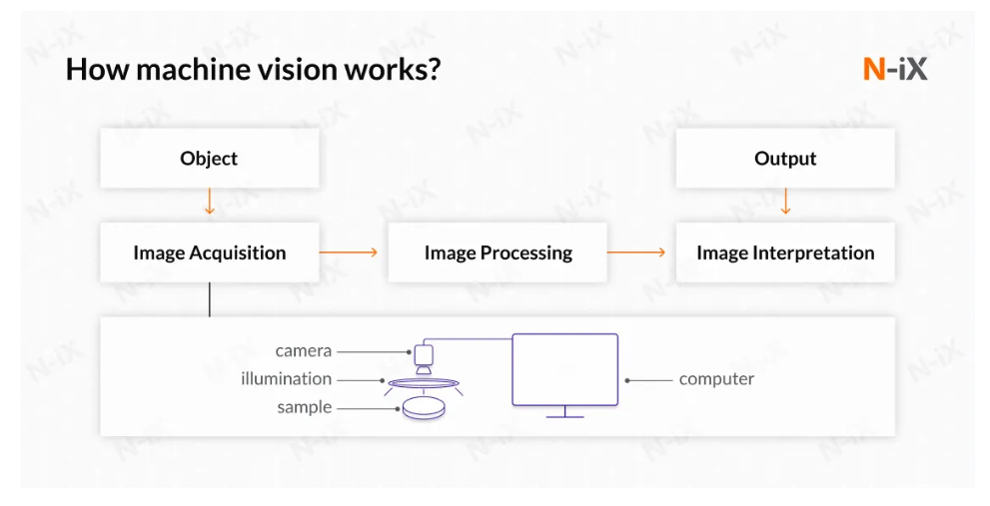

Slide 6
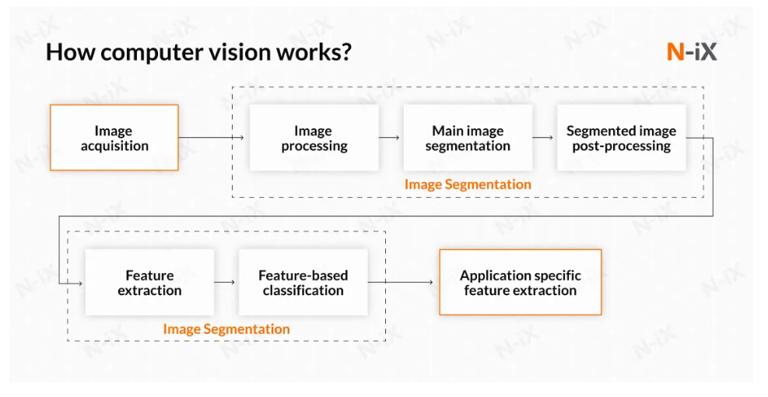

Slide 7
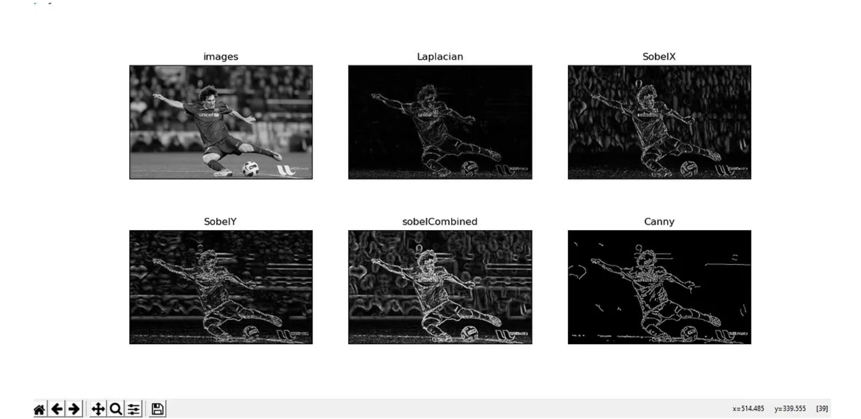
Canny Edge Detection
It is an edge detection operator that uses a multi-stage algorithm to detect a wide range of edges in images . It was developed by John F. Canny ,an Australian computer scientist, back in 1986.
The Canny edge detection algorithm is composed of 5 steps:
Noise reduction;
Gradient calculation;
Non-maximum suppression;
Double threshold;
Edge Tracking by Hysteresis.

Slide 8
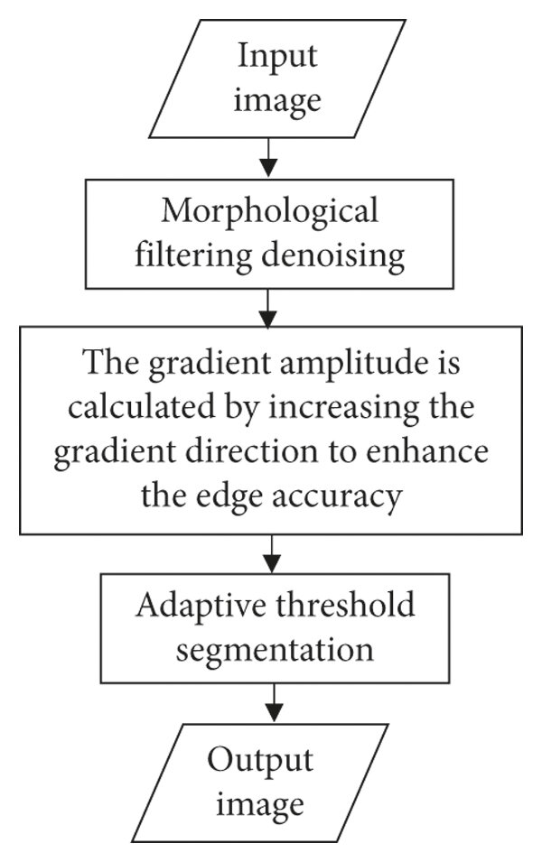
Canny Edge Detection’s flowchart

Slide 9
What is OpenCV Library?
OpenCV, short for Open Source Computer Vision Library, is an open-source computer vision and machine learning software library. Originally developed by Intel, it is now maintained by a community of developers under the OpenCV Foundation.
OpenCV- Introduction
Opencv is a huge open-source library for computer vision, machine learning, and image processing. Now, it plays a major role in real-time operation which is very important in today’s systems. By using it, one can process images and videos to identify objects, faces, or even the handwriting of a human.
When it is integrated with various libraries, such as NumPy, python is capable of processing the opencv array structure for analysis. To Identify an image pattern and its various features we use vector space and perform mathematical operations on these features.

Slide 10
Applications of OpenCV
There are lots of applications which are solved using OpenCV, some of them are listed below:
Face recognition
Automated inspection and surveillance
number of people – count (foot traffic in a mall, etc)
Vehicle counting on highways along with their speeds
Interactive art installations
Anomaly (defect) detection in the manufacturing process (the odd defective products)
Street view image stitching
Video/image search and retrieval
Robot and driver-less car navigation and control
object recognition
Medical image analysis
Movies – 3D structure from motion
TV Channels advertisement recognition

Slide 11
How does a computer read an image?
Computers don’t “see” images in the way humans do. Instead, they interpret images as arrays of numerical values. The basic process of how a computer reads and processes an image are:
Pixel Values: An image is made up of pixels, which are the smallest units of information in an image. Each pixel has a value that represents its color and intensity. In the case of an RGB image, there are three values for each pixel corresponding to the Red, Green, and Blue channels.
Digital Representation: The RGB values are usually represented as integers ranging from 0 to 255. 0 represents the absence of color (black), and 255 represents the maximum intensity of that color (full brightness).
Image Matrix: The computer reads the image as a matrix of numbers, where each element in the matrix corresponds to the pixel value at that location. For a color image, there are typically three matrices, one for each RGB channel.
Image Processing: Image processing algorithms are applied to manipulate these numerical representations. Common operations include resizing, cropping, filtering, and more.

Slide 12
Canny algorithm
import cv2
import numpy as np
import matplotlib.pyplot as plt
# Load the image
image = cv2.imread(‘Song_Jia.jpg', cv2.IMREAD_GRAYSCALE)
# Apply GaussianBlur to reduce noise
smoothed_image = cv2.GaussianBlur(image, (5, 5), 0)
# Apply Canny edge detector
edges = cv2.Canny(smoothed_image, threshold1=50, threshold2=150)
# Display the results
plt.figure(figsize=(8, 4))
plt.subplot(121), plt.imshow(image, cmap='gray')
plt.title('Original Image'), plt.xticks([]), plt.yticks([])
plt.subplot(122), plt.imshow(edges, cmap='gray')
plt.title('Edge Image'), plt.xticks([]), plt.yticks([])
plt.show()

Slide 13
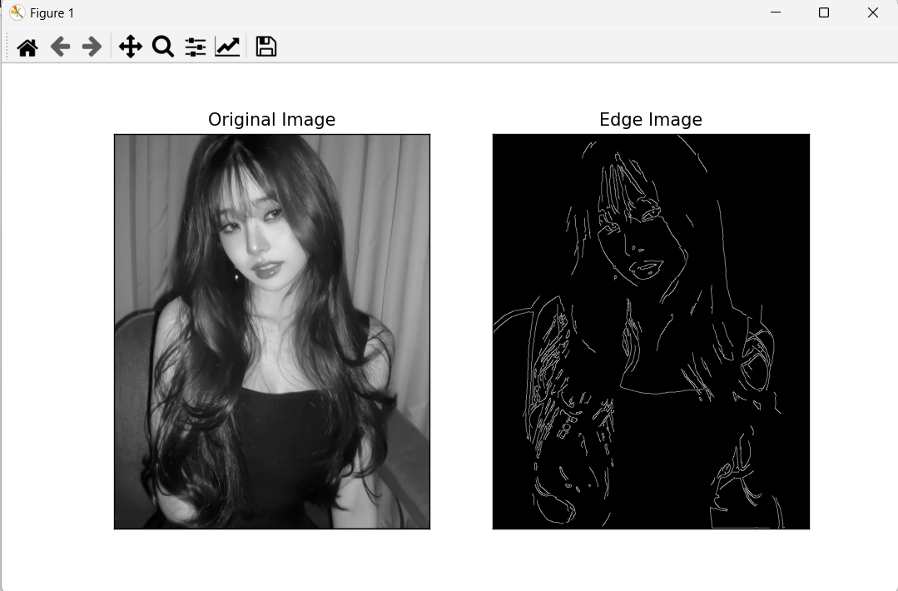
Canny algorithm example

Slide 14
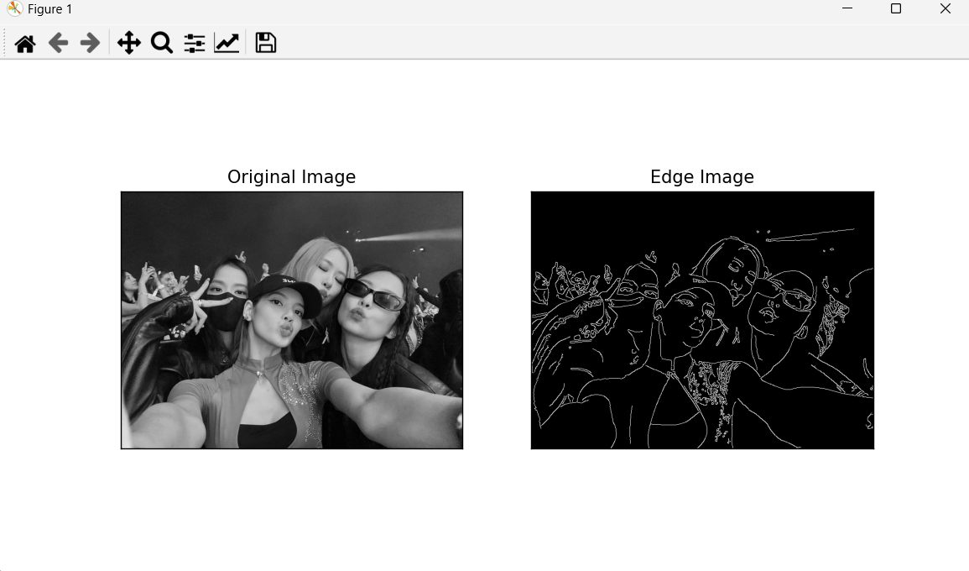
Canny algorithm example

Slide 15
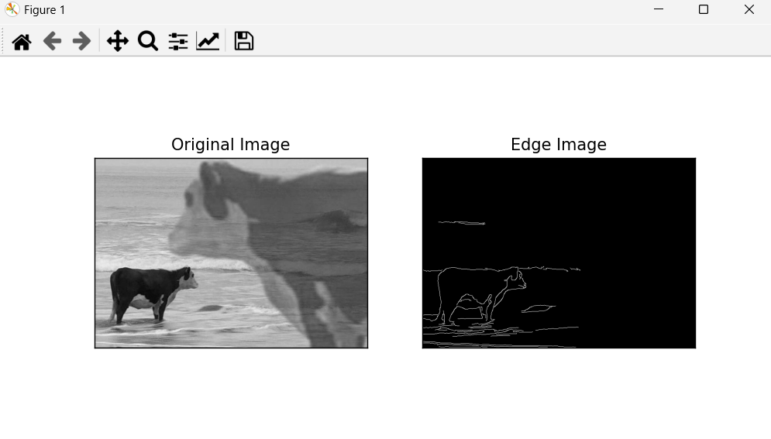
Canny algorithm example

Slide 16
Sobel Detection Algorithm
The Sobel algorithm was developed by Irwin Sobel and Gary Feldman at the Stanford Artificial Intelligence Laboratory (SAIL) in 1968.
In the simplest terms, their algorithm works by running a 3x3 matrix (known as the kernel) over all the pixels in the image. At every iteration, we measure the change in the gradient of the pixels that fall within this 3x3 kernel. The greater the change in pixel intensity, the more significant the edge there is.

Slide 17
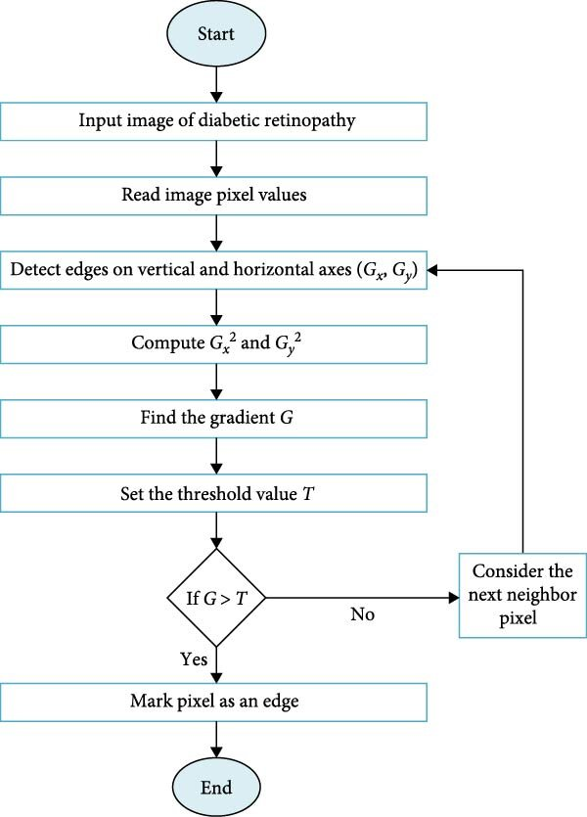
Sobel algorithm’s flowchart

Slide 18
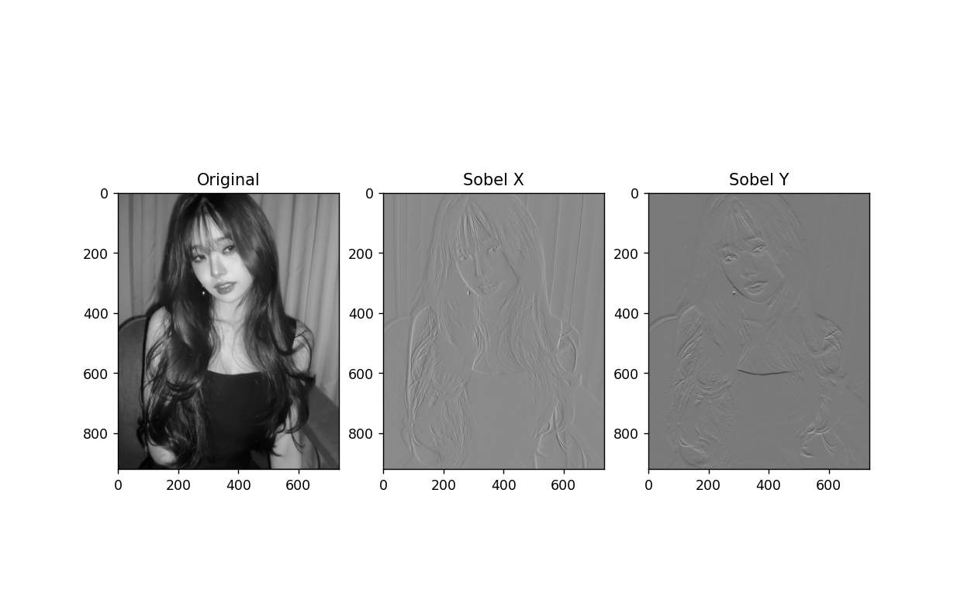
Sobel algorithm example

Slide 19
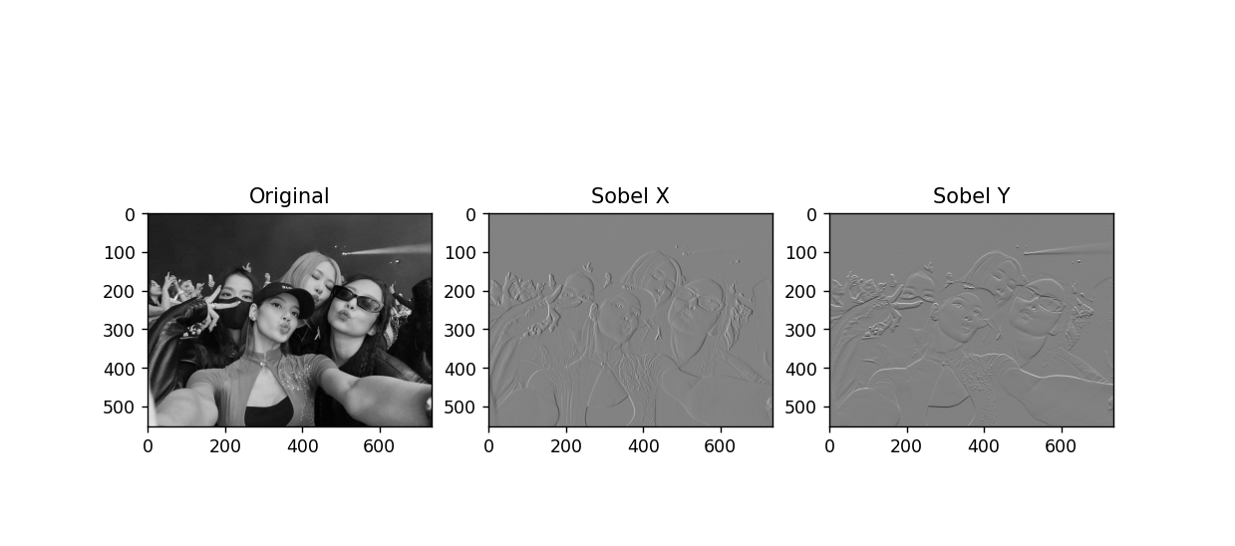
Sobel algorithm example

Slide 20
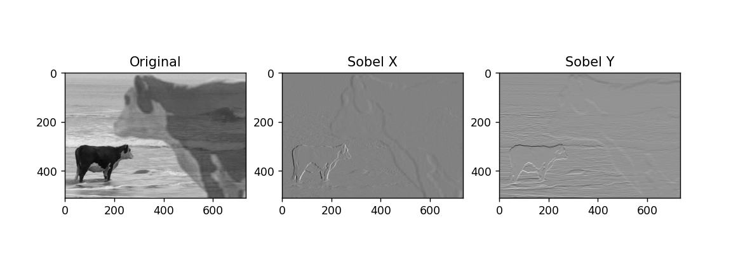
Sobel algorithm example

Slide 21
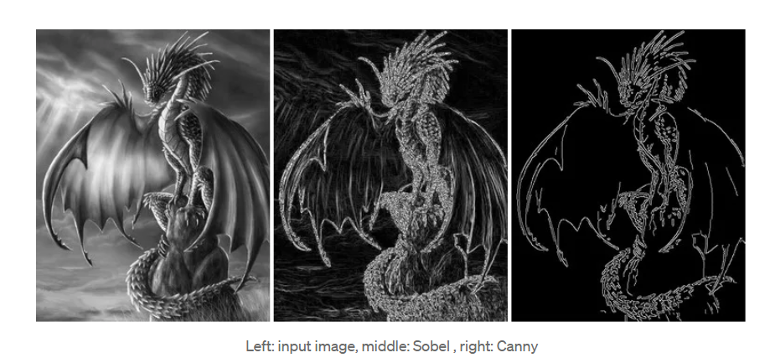
Conclusion
The main advantages of the Sobel operator are that it is simple and more time-efficient. However, the edges are rough. On the other hand, the Canny technique produces smoother edges due to the implementation of Non-maxima suppression and thresholding. The downside of the Canny algorithm is that it is more complex and less time-efficient than Sobel. Knowing these differences is helpful in deciding which technique is better for a particular application.

Slide 22

Thank you for attention

Slide 23
References
Lina Haidar. Sobel vs. Canny Edge Detection Techniques: Step by Step Implementation. Medium. – URL: https://medium.com/@haidarlina4/sobel-vs-canny-edge-detection-techniques-step-by-step-implementation-11ae6103a56a (11.09.2021)
Aryaman Shadra. How Image Edge Detection Works. Medium. – URL: https://aryamansharda.medium.com/how-image-edge-detection-works-b759baac01e2(01.10.2018)
Simarpreet Singh. What is Canny Edge Detection?. Medium. – URL: https://medium.com/simply-dev/what-is-canny-edge-detection-cfefa272a8d0 (09.04.2020)
Yaroslav Mota. Machine vision vs computer vision: Which one is the best choice. – URL: https://www.n-ix.com/machine-vision-vs-computer-vision/(06.09.2024)
EnCata. Differentiating Machine Vision and Computer Vision. Medium. – URL: https://medium.com/@encata/differentiating-machine-vision-and-computer-vision-9c1df1506dd0 (29.07.2024)
Geekforgeeks. What is OpenCV Library?. – URL: https://www.geeksforgeeks.org/opencv-overview/ (15.04.2024)
Geekforgeeks. Sobel Edge Detection vs. Canny Edge Detection in Computer Vision. – URL: https://www-geeksforgeeks-org.translate.goog/sobel-edge-detection-vs-canny-edge-detection-in-computer-vision/?_x_tr_sl=en&_x_tr_tl=ru&_x_tr_hl=ru&_x_tr_pto=sc

Slide 24
